Slide 1

Subject Name: Advanced Algorithms
Unit No:2
Unit Name: Probabilistic Analysis and Randomized Algorithm
Faculty Name : Ms Vanita Mane.

Slide 2
Module No 1: Probabilistic Analysis and Randomized Algorithm
Lecture No: 9
Probabilistic analysis

Slide 3
Introduction
Worst-Case Running Time
  We are interested on how the running time scales with input size
Normally we are interested in worst case running time
(worst case of all inputs of a given size)
Definition - Worst-Case Running Time
  I - some input
  T(I) - running time for input I
  T(n) - worst-case running time for input size n
  T(n) = max{T(I)}inputs I of size n
Lecture No: 9 Probabilistic analysis

Slide 4

Introduction cont….
Average case analysis
We could be interested in average-case
Measure performance in ”typical” inputs
  What is a typical input?
There are algorithms with large gap between ”average performance”
and worst case.
Can we improve worst-case by adding randomization?
Lecture No: 9 Probabilistic analysis

Slide 5
Module No 1: Probabilistic Analysis and Randomized Algorithm
Lecture No:10
Probabilistic analysis example

Slide 6
Probabilistic Analysis
Probabilistic Analysis
  The use of probability in the analysis of algorithms
We must have some knowledge or make assumptions about the distribution of the input
We can then make an average-case analysis, averaging the cost over all possible inputs
For our problem, we could assume all possible permutations are equally likely (the ranks form an uniform random permutation).
Lecture 10: Probabilistic analysis example

Slide 7
Randomized algorithms
Randomized algorithms
We call an algorithm randomized if its behavior is determined not only by its input but also by values produced by a random-number generator
Most programming environments offer a (deterministic) pseudorandom-number generator: it returns numbers that ”look” statistically random
We typically refer to the analysis of randomized algorithms by talking about the expected cost (ex: the expected running time)
We can use probabilistic analysis to analyse randomized algorithms
Lecture 10: Probabilistic analysis example

Slide 8
Lecture No: 11
The hiring problem

Slide 9
The Hiring Problem
We will now begin our investigation of randomized algorithms with a toy problem:
You want to hire an office assistant from an employment agency.
You want to interview candidates and determine if they are better than the current assistant and if so replace the current assistant.
You are going to eventually interview every candidate from a pool of n candidates.
You want to always have the best person for this job, so you will replace an assistant with a better one as soon as you are done the interview.
However, there is a cost to fire and then hire someone.
You want to know the expected price of following this strategy until all n candidates have been interviewed.
Lecture No 11: The hiring problem

Slide 10
The Hiring Problem-Pseudo Code
Hire-Assistant(n)
best <- dummy candidate
for i <- 1 to n
do interview of candidate I
if candidate i is better than best
then best <- I
hire candidate i
Lecture No 11: The hiring problem

Slide 11
The Hiring Problem-Total Cost
Interviewing has a low cost ci
Hiring has a high cost ch
Let n be the number of candidates to be interviewed and let m be the number of people hired.
The total cost then goes as O(n*ci +m*ch)
The number of candidates is fixed so the part of the algorithm we want to focus on is the m*ch term.
This term governs the cost of hiring.
Lecture No 11: The hiring problem

Slide 12
The Hiring Problem-Worst Case Analysis
In the worst case, everyone we interview turns out to be better than the person we currently have.
In this case, the hiring cost for the algorithm will be O(n*ch).
This bad situation presumably doesn’t typically happen so it is interesting to ask what happens in the average case.
Lecture No 11: The hiring problem

Slide 13
Lecture No: 12
The hiring problem

Slide 14
The Hiring Problem-Probabilistic Analysis
Probabilistic analysis is the use of probability to analyze problems.
One important issue is what is the distribution of inputs to the problem.
For instance , we could assume all orderings of candidates are equally likely.
That is, we consider all functions rank: [0..n] --> [0..n] where rank[i] is supposed to be the ith candidate that we interview. So <rank(1), rank(2), …rank(n)> should be a permutation of <1,…,n>
There are n! many such permutations and we want each to be equally likely.
If this is the case, the ranks form a uniform random permutation.
Lecture No 12: The hiring problem

Slide 15
The Hiring Problem-Randomized algorithms
In order to use probabilistic analysis, we need to know something about the distribution of the inputs.
Unfortunately, often little is known about this distribution.
We can nevertheless use probability and analysis as a tool for algorithm design by having the algorithm we run do some kind of randomization of the inputs.
This could be done with a random number generator. i.e.,
We could assume we have primitive function Random(a,b) which returns an integer between integers a and b inclusive with equally likelihood.
Algorithms which make use of such a generator are called randomized algorithms.
In our hiring example we could try to use such a generator to create a random permutation of the input and then run the hiring algorithm on that.
Lecture No 12: The hiring problem

Slide 16
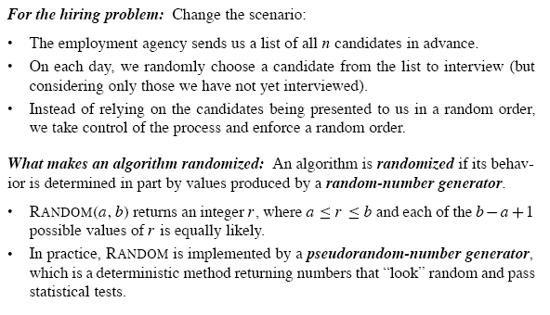
The Hiring Problem-Randomized algorithms
Lecture No 4: Master Theorem

Slide 17

The Hiring Problem-Analysis using Indicator Random Variable
Let Xi be the indicator random variable which is 1 if candidate i is hired and 0 otherwise.
Let
By our lemma E[Xi ] = Pr{candidate i is hired}
Candidate i will be hired if i is better than each of candidates 1 through i-1.
As each candidate arrives in random order, any one of the first candidate i is equally likely to be the best candidate so far. So E[Xi ] =1/i.
Lecture No 12: The hiring problem

Slide 18

The Hiring Problem-Analysis using Indicator Random Variable
Lemma Assume that the candidates are presented in random order, then algorithm Hire-Assistant has a hiring cost of O(chln n)
Proof. From before hiring cost is O(m*ch) where m is the number of candidate hired. From the lemma this is O(ln n).
Lecture No 12: The hiring problem

Slide 19
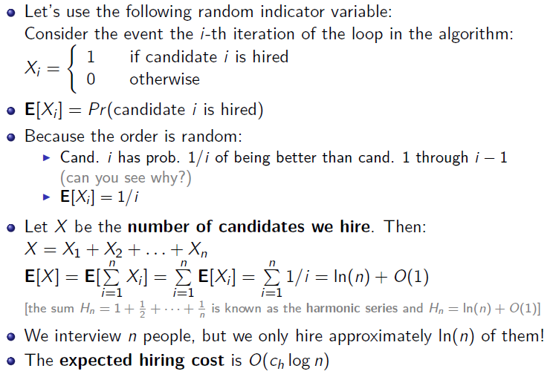
The Hiring Problem-Analysis using Indicator Random Variable
Lecture No 12: The hiring problem

Slide 20
Thank You

